Slide 2
Azure Service Fabric, microservices, containers, and the road ahead
B8106
Mark Fussell
Program Manager
Vaclav Turecek
Program Manager

Slide 3
Objectives
How to progressively modernize apps with microservices
Service Fabric as a container orchestrator
Roadmap for Service Fabric

Slide 4

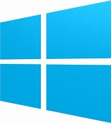

Azure Service Fabric
Any OS, Any Cloud
Service Fabric Windows SDK
Available
Service Fabric in Azure Stack GA
Coming 2017
Service Fabric on Linux in Azure
Preview
Service Fabric for Linux
Coming 2017
Service Fabric on Windows in Azure
Available
Service Fabric on Linux in Azure
Available Preview
Service Fabric for Windows Server
Available
Lifecycle
Management
Always On Availability
Programming Models
Health & Monitoring
Dev & Ops Tooling
Auto
scaling
Orchestration
Dev Box
Azure
On Premise
Other Clouds

Slide 5



Service Fabric Programming Models & CI/CD
Visual
Studio
&
VSTS
Jenkins
&
Eclipse
ASP.NET Core
Reliable Actors
Diagnostics & Monitoring
AppInsights
OMS
ELK
Reliable Services
Guest Executables
Containers
Lifecycle
Management
Auto
scaling
Lifecycle
Management
Always On Availability
Orchestration
Programming Models
Health & Monitoring
Dev & Ops Tooling
Auto
scaling
Dev Box
Azure
On Premise
Other Clouds

Slide 6




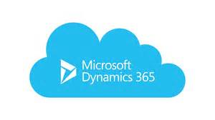

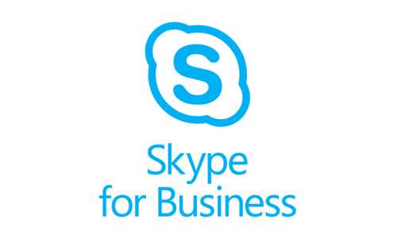

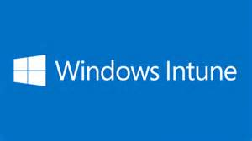
Services Powered by Service Fabric
Document DB
Billions transactions/day
IoT Hub
Millions of messages
Event Hubs
60bn events/day
SQL Database
2.1 million DBs
Cosmos DB
Billions transactions/day
30% of Azure cores run Service Fabric
Skype
Cortana
Intune
Dynamics
Power BI
Designed for mission critical tier 1 workloads

Slide 7










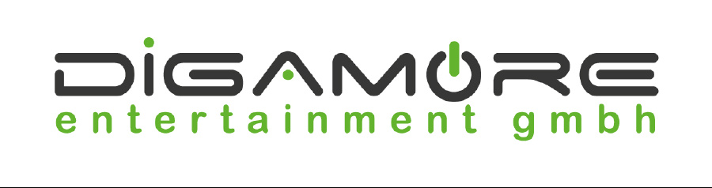













Slide 8



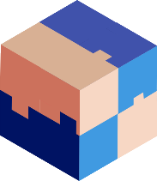



Migrating a traditional application to microservices
Traditional app
Hosted as guest executables or containers in Service Fabric
Simple modernization - new microservices added alongside
Deeper modernization - breaking app into microservices
Transformed into microservices
…You can stop at any stage

Slide 9
Containers and Orchestration

Slide 10

Container images
Image Contents
Registry
Folders and Files
My Website
Application
HKLM
inetpub
mysite.html
IIS
SOFTWARE/mykey
Application Framework
Image Contents
Registry
Folders and Files
HKLM
HKCU
License.txt
PerfLogs
Program Files
Base Image (OS)
HKCR
HKU
Program Files (x86)
Users
Windows

Slide 11
Announcing: GA Windows Container Orchestrator

Slide 12
Service Fabric and Containers
Image deployment and activation
Support for authenticating with private registry
Environment variables to provide inputs to the container
Volume driver support
Mounting of persistent volumes drives
Networking
Bridge network: Mapping of container ports to dynamic ports on host machine
Registration of container endpoints with the Naming Service for communicating between containers
DNS service within cluster to resolve container endpoints
Resource governance
Apply policy on containers for resource constraints and use them during placement. CPU, memory, I/O
Process constraints: Extending constraints and governance to processes
Windows containers with Hyper-V isolation
Preview: Support for Docker Compose
Dv3
Ev3
New generation of D family
High memory

Slide 13
Migrating a traditional application to microservices
Traditional app
Hosted as guest executables or containers in Service Fabric
Simple modernization - new microservices added alongside
Deeper modernization - breaking app into microservices
Transformed into microservices
…You can stop at any stage

Slide 14

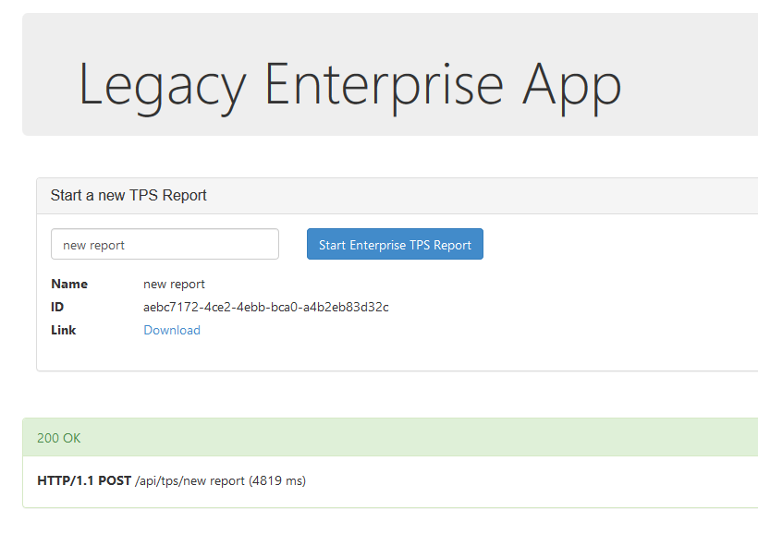
Legacy application: Lift-and-shift
Service Fabric cluster
Docker Compose
Front-end web service
Back-end web service
container
container
DNS
Service

Slide 15
Demo: Lift-and-shift
Deploying Docker Compose applications to Service Fabric

Slide 16
Container networking: the road ahead
Per application isolated network
Isolated network when communicating between multiple containers deployed as an application
Similar to an overlay network
Fixed IP addresses for each container
When a container fails over, it retains the same IP address when activated on a new node.
Container can be addressed directly and use NSGs and LBs etc
Easy to use with DNS
Node 1
Node 2
10.0.0.0/255
10.0.0.1
10.0.0.4
175.10.10.3
195.167.10.3

Slide 17
Containers: the road ahead
Resource governance
Preconfigured capacity constraints on Azure clusters using containers resource type. e.g. CPU, memory
Service Fabric programming models inside containers
Reliable Services and Reliable Actors
Deeper VS integration for local container debugging and visualization of containers in Service Fabric Explorer
Local storage volume driver
Mounting of persistent volumes to local disk storage for extremely fast failover and low latency

Slide 18
Demo: Stateful Container Failover
Local storage volume driver

Slide 19
Modernize your Applications with Service Fabric

Slide 20
Migrating a traditional application to microservices
Traditional app
Hosted as guest executables or containers in Service Fabric
Simple modernization - new microservices added alongside
Deeper modernization - breaking app into microservices
Transformed into microservices
…You can stop at any stage
Notes:
Next phase: add new supporting services without changing monolith application.

Slide 21
Modernize with Service Fabric
Service Fabric cluster
Service Fabric cluster
Docker Compose
fabric:/application
ASP.NET Core Reliable Service 1
container
container
ASP.NET Core Reliable Service 2
container
container
Notes:
Modify your monolith to make requests to your new service.
Reverse Proxy to route requests

Slide 22
Hosting ASP.NET Core in Service Fabric
WebHost in its own process
Host process
Server
Kestrel or WebListener
Program Main()
ASP.NET Core WebHost
Create
Application
MVC, etc

Slide 23
Hosting ASP.NET Core in Service Fabric
WebHost in a Reliable Service
Service host process
Program Main()
Service instance/replica (multiple)
Register
service type
ASP.NET Core
Service Fabric runtime
Server
Kestrel or WebListener
Create
ICommunication-Listener
ASP.NET Core WebHost
Create
Application
MVC, etc

Slide 24
Demo: modernization part 1
Service Fabric application with ASP.NET Core stateful Reliable Services and containerized legacy services
Notes:
IIS Classic App in guest container + New stateful service in one application
Show VS 2017 refresh mode.

Slide 25
Gateway to your application
Service Fabric cluster
?
Service Fabric
Reverse Proxy
ASP.NET Core
Stateful Service
Notes:
Modify your monolith to make requests to your new service.
Reverse Proxy to route requests

Slide 26
Gateway to your application: stateless service
VNET
Service Fabric cluster
Node 1
Secondary
RP
Node 2
RP
Primary
Node 3
Secondary
RP
Notes:
Modify your monolith to make requests to your new service.
Reverse Proxy to route requests

Slide 27
Announcing: Service Fabric + API Management
Service discovery and routing
Partition resolution
Replica selection
Resolve and retry policies
+
Service Fabric
Notes:
Use Azure API Management to create an API layer across services.

Slide 28
Gateway to your application: API Management
Service discovery and routing
Service Fabric cluster
Reliable Service 1
fabric:/app/service/1
/api/users/{id}
fabric:/app/service/{id}
Reliable Service 2
fabric:/app/service/2
…
Reliable Service n
fabric:/app/service/n
Notes:
Use Azure API Management to create an API layer across services.

Slide 29
Gateway to your application: API Management
Partition resolution
Service Fabric cluster
Reliable Service
/api/users/{id}
GetPartitionKey({id})
Partition 1
Partition 2
…
Partition n
Notes:
Use Azure API Management to create an API layer across services.

Slide 30
Gateway to your application: API Management
Service Fabric cluster
ASP.NET Core
Reliable Service
Notes:
Use Azure API Management to create an API layer across services.

Slide 31
Gateway to your application: API Management
VNET
Service Fabric cluster
Node 1
Secondary
Node 2
Primary
Node 3
Secondary
Naming
Service
Notes:
Use Azure API Management to create an API layer across services.

Slide 32
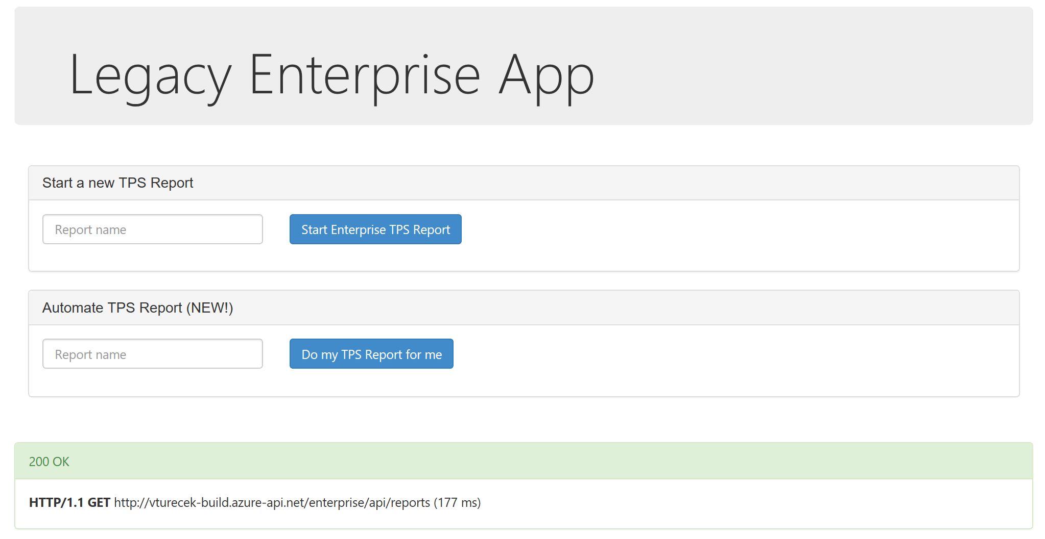
Legacy application: Modernized
Service Fabric cluster
Web UI
GET /Index
fabric:/ModernApp/LegacyWebService
POST /api/tps/{name}
fabric:/ModernApp/LegacyDataService
POST /api/tps/{name}
DELETE /api/reports/{name}
DELETE /api/reports/{name}
fabric:/ModernApp/ReportController
API
POST /api/reports/{name}
POST /api/reports/{name}
GET /api/reports/
GET /api/reports
GET /api/reports/{name}/status
fabric:/ModernApp/Tps/Processing/{name}
Report Processing Service
GET /api/status
Report Processing Service
Notes:
Use Azure API Management to create an API layer across services.

Slide 33
Demo: modernization part 2
Azure API Management gateway

Slide 34



Gateway to your application: lots of options!
stateless web gateway
Service Fabric
Azure Load Balancer
Service Fabric
Azure API Management
IoT Hub
Service Fabric
Service Fabric
Event Hub

Slide 35
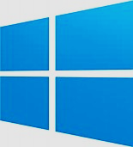
Programming models - Windows
Your service
Full .NET Framework
Your service
Any language
ASP.NET Core
Reliable Actors
Reliable Services
Guest Executables
Containers
Notes:
Full .NET Framework on Windows today.

Slide 36

Programming models – Linux (preview)
Your service
Java, .NET Core
Your service
Any language
ASP.NET Core
Reliable Actors
(stateful)
Reliable Services (stateless only)
Guest Executables
Containers
Notes:
Java and .NET Core stateless services today.
Stateful actors in Java only.

Slide 37
Programming models – The Road Ahead
Your service
.NET Core, Full .NET, Java
Your service
Any language
ASP.NET Core
Reliable Actors
Reliable Services
Guest Executables
Containers
.NET Standard 2.0, Java
Containers
Notes:
Future: Cross-plat .NET Core possible for both stateless and stateful.

Slide 38
Programming models are open source!
Reliable Services and Actors
https://github.com/Azure/service-fabric-services-and-actors-dotnet
Reliable Services ASP.NET Core integration
https://github.com/Azure/service-fabric-aspnetcore
Service Fabric home
https://github.com/Azure/service-fabric
Notes:
Future: Cross-plat .NET Core possible for both stateless and stateful.

Slide 39
Cluster and Application Management
Azure ARM Powershell module for cluster management
Azure CLI 2.0 coming soon
CLI 2.0 for managing applications
Connects directly to cluster
Single node cluster for dev/test purposes
Patching service integrated with Windows Update service for automated VMSS patching
Integration with AppInsights and OMS for Containers
T6084 - Managing secure, scalable Azure Service Fabric clusters and applications

Slide 40
Demo: Windows Server Container Scale

Slide 41
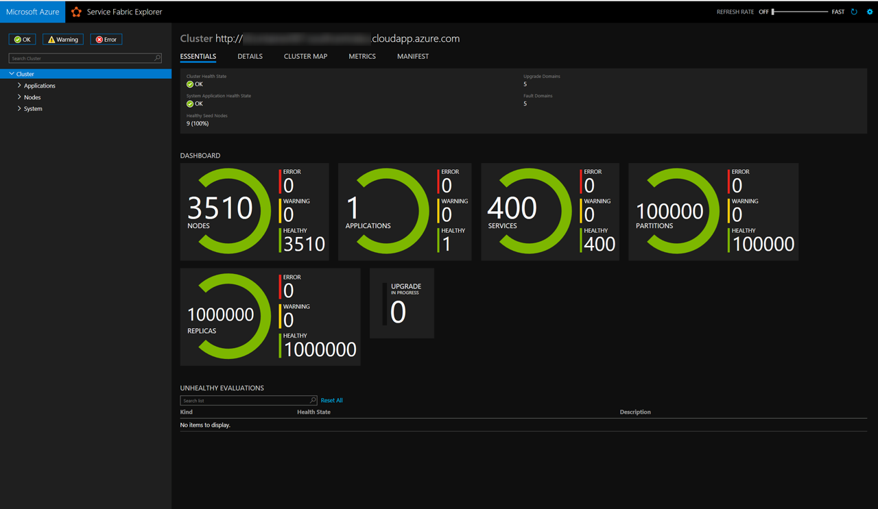
Containers

Slide 42
Service Fabric sessions
Date | ID | Breakout Sessions
Wed 5:00PM | B8087 | Azure Compute: New features and roadmap
Thurs 4:00PM | T6001 | Azure Service Fabric, microservices, containers, and the road ahead
Fri 9:00AM | B8013 | Developing on Windows Server: Innovation for today and tomorrow - containers, Docker, .NET Core, Service Fabric, and more
Date | ID | Theatre Sessions
Wed 1:30PM Fri 1:00PM | T6968-R1 | Service Fabric architecture in the SwissRe Digital Platform: An IoT scenario
Wed 1:30PM | T6089 | How Wolters Kluwer created an isolated job system and containerization strategy on Azure Service Fabric
Wed 7:30PM | T6051 | Microservice architecture with ASP.NET Core
Thurs 1:00PM | T6084 | Managing secure, scalable Azure Service Fabric clusters and applications
Thurs 4:30PM | T6001 | Containerizing your Microsoft ASP.NET 4.x apps

Slide 43
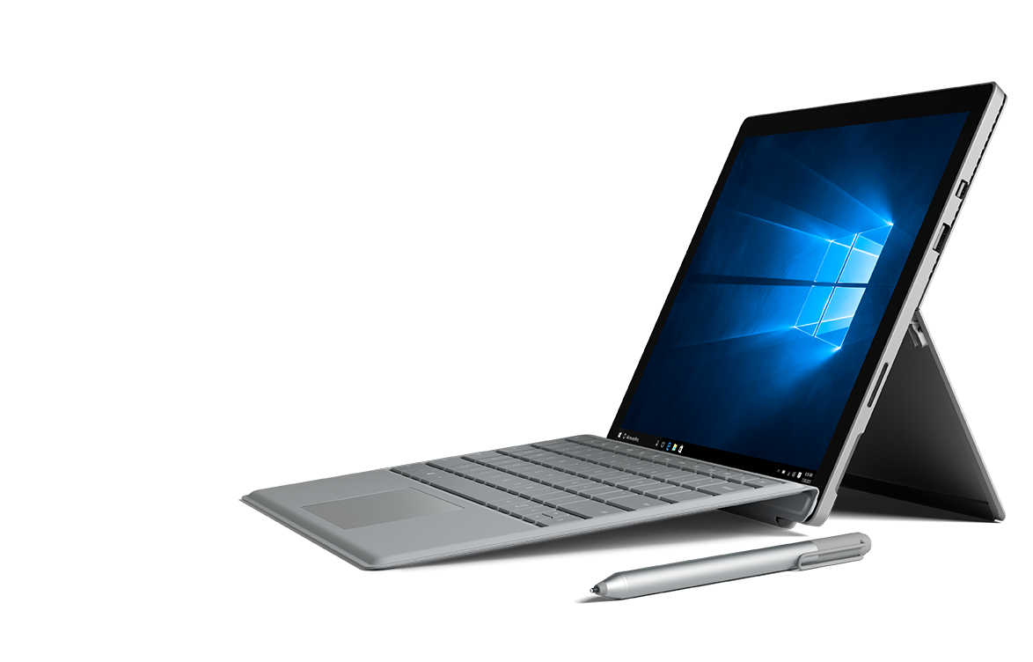
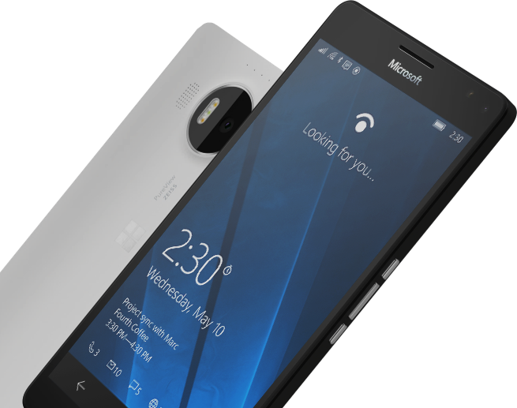
Please Complete An Evaluation Form for every session you attend.
Your input is important!
#MSBuild

Slide 44

Call to action
Questions? Comments? Issues?
https://stackoverflow.com/questions/tagged/azure-service-fabric
http://aka.ms/servicefabricforum
https://github.com/azure/service-fabric-issues
Learn from blog, free clusters, samples and labs
http://aka.ms/servicefabricblog
http://aka.ms/tryservicefabric –>returning soon.
http://aka.ms/servicefabricsamples
http://aka.ms/sflab1 and http://aka.ms/sflab2
Come down to the booth at the Hub
#MSBuild

